Slide 1
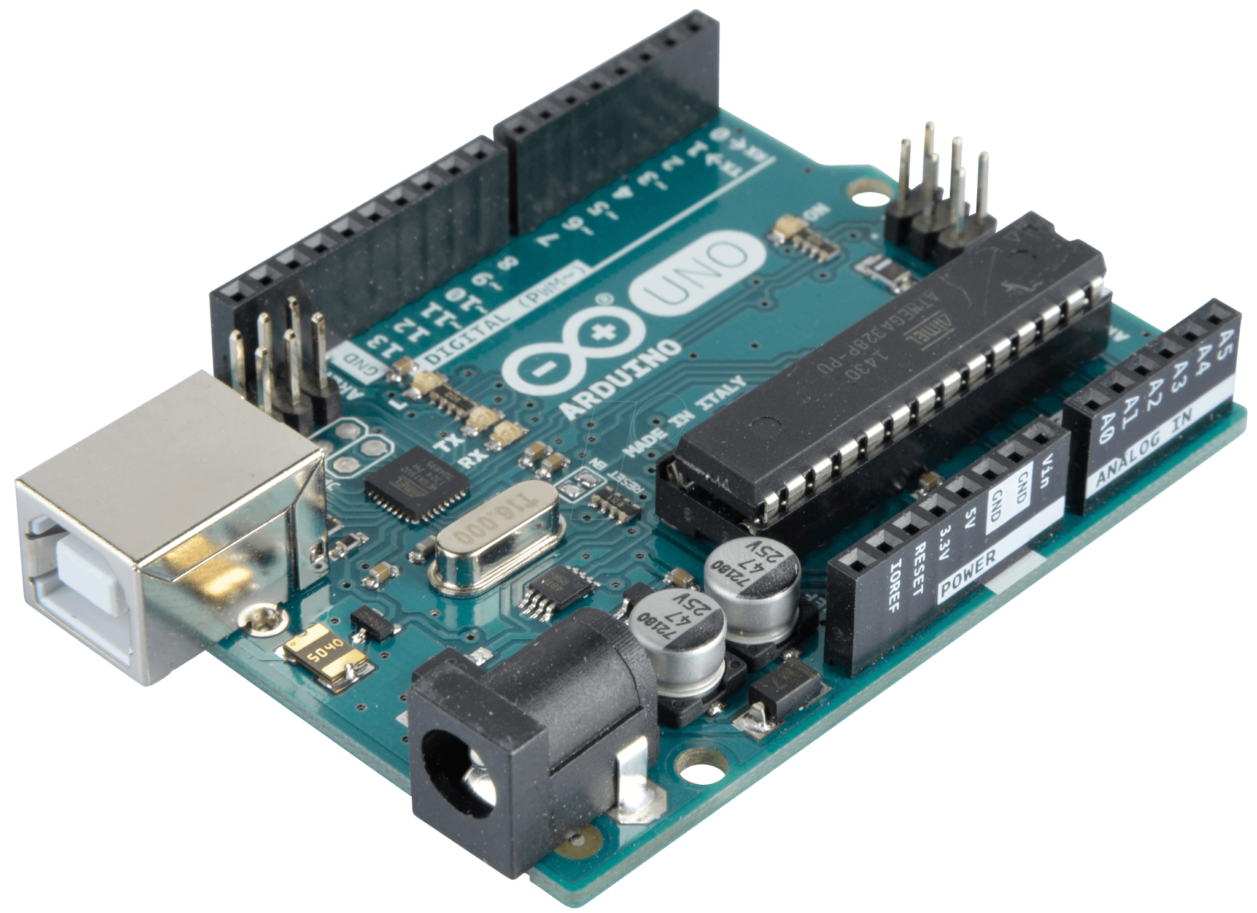


What the $~#!*+
are embedded systems ?
Prepared by:
Radhi SGHAIER, github.com/Rad-hi

Slide 2

Context, and today’s four questions !
Who is TRAINER_NAME ?
What the hell are embedded systems ?
How do they work ?
Why you should get involved ?

Slide 3
1
Who’s TRAINER_NAME, and why might I consider listening to what (s)he’s saying ?

Slide 4
Who’s TRAINER_NAME

Slide 5
Who’s TRAINER_NAME

Slide 6
2
What the hell are embedded systems anyway ?

Slide 7
Actuation
Perception
Computation

Slide 8


Slide 9
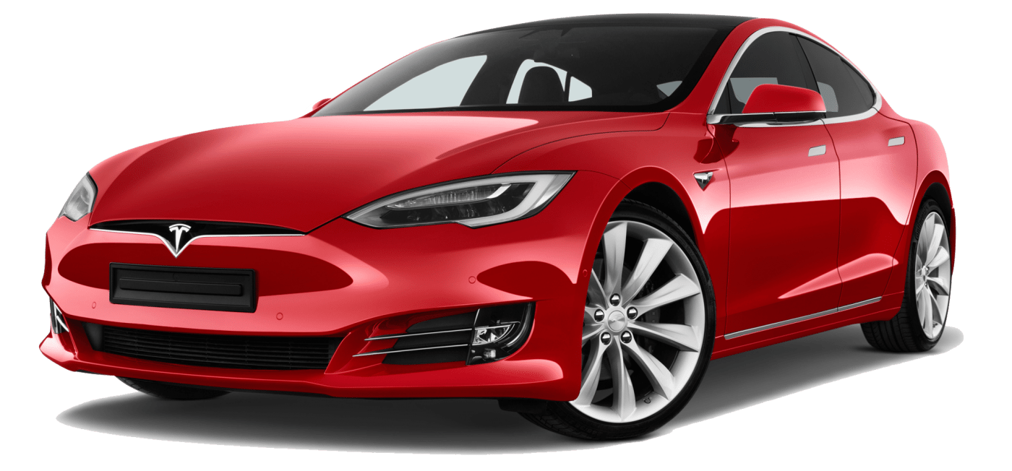
"If you think about what we're doing right now with the cars, Tesla is arguably the world's biggest robotics company, because cars are like semi-sentiment, robots on wheels," _ Elon Musk

Slide 10

Smart, and connected light-bulb.

Slide 11
3
How do they work though ?

Slide 12
It’s fiddling time !

Slide 13
4
Okay okay,
why should I care ?

Slide 14

You’re in demand, forever !
According to the top tech 14 skills in demand 2019, Internet Of Things (IoT), Machine Learning, and Artificial Intelligence (AI), which are core fields in embedded systems, are one of the most highly paid jobs.

Slide 15

You get to fail, and learn by building !

Slide 16

You become just as cool as Dexter !

Slide 17
Thank you for your attention

